Slide 1
Fig. 4a
fROC curves of all mammograms in mini-MIAS database, scoring each ROI.
The solid line represents the scoring using fused features, while the dotted line – using unilateral features.

Slide 2
Fig. 4b
fROC curves of all mammograms in mini-MIAS database divided into density categories, scoring each ROI.
The solid lines represent the scoring using fused features, while the dotted lines – using unilateral features.

Slide 3
Table 4
LLF values of mini-MIAS database in NLF = 1
Density category | Fused features | Unilateral features
Fatty | 0.7569 | 0.8102
Glandular | 0.8422 | 0.6437
Dense | 0.6778 | 0.5468
All | 0.7342 | 0.6308

Slide 4
Fig. 5a
ROC curves of all mammograms in mini-MIAS database, scoring each case.
The solid line represents the scoring using fused features, while the dotted line – using unilateral features.

Slide 5
Fig. 5b
ROC curves of all mammograms in mini-MIAS database divided into density categories, scoring each case.
The solid lines represent the scoring using fused features, while the dotted lines – using unilateral features.

Slide 6
Table 5
AUC values of mini-MIAS database
Density category | Fused features | Unilateral features
Fatty | 0.8124 | 0.7871
Glandular | 0.8065 | 0.6792
Dense | 0.7275 | 0.7169
All | 0.8035 | 0.7447

Slide 7
Fig. 6a
fROC curves of all mammograms with bilateral counterpart in INBreast database, scoring each ROI. All anomalies are considered as positive ROIs.
The solid line represents the scoring using fused features, while the dotted line – using unilateral features.

Slide 8
Fig. 6b
fROC curves of all mammograms with bilateral counterpart in INBreast database, divided into density categories, scoring each ROI. All anomalies are considered as positive ROIs.
The solid lines represent the scoring using fused features, while the dotted lines – using unilateral features.

Slide 9
Table 6
LLF values of INBreast database in NLF = 1. All anomalies are considered as positive ROIs.
Density category | Fused features | Unilateral features
ACR 1 | 0.7063 | 0.6676
ACR 2 | 0.8350 | 0.7805
ACR 3 | 0.7483 | 0.7399
ACR 4 | 0.6788 | 0.4444
All | 0.7466 | 0.7163

Slide 10
Fig. 7a
ROC curves of all mammograms with bilateral counterpart in INBreast database, scoring each mammogram. All anomalies are considered as positive ROIs.
The solid line represents the scoring using fused features, while the dotted line – using unilateral features.

Slide 11
Fig. 7b
ROC curves of all mammograms with bilateral counterpart in INBreast database, scoring each case. All anomalies are considered as positive ROIs.
The solid line represents the scoring using fused features, while the dotted line – using unilateral features.

Slide 12
Table 7
AUC values of INBreast database. All anomalies are considered as positive ROIs.
Density category | Fused features | Unilateral features
Mammogram-based | 0.8234 | 0.7513
Case-based | 0.7574 | 0.7304

Slide 13
Fig. 8a
fROC curves of all mammograms with bilateral counterpart in INBreast database, scoring each ROI. Only highly suspicious anomalies (BIRADS >=4) are considered as positive ROIs.
The solid line represents the scoring using fused features, while the dotted line – using unilateral features.

Slide 14
Fig. 8b
fROC curves of all mammograms with bilateral counterpart in INBreast database, divided into density categories, scoring each ROI. Only highly suspicious anomalies (BIRADS >=4) are considered as positive ROIs.
The solid lines represent the scoring using fused features, while the dotted lines – using unilateral features.

Slide 15
Table 8
LLF values of INBreast database in NLF = 1. Only highly suspicious anomalies (BIRADS >=4) are considered as positive ROIs.
Density category | Fused features | Unilateral features
ACR 1 | 0.7539 | 0.7262
ACR 2 | 0.8529 | 0.7647
ACR 3 | 0.7333 | 0.6909
ACR 4 | 1.0000 | 0.7778
All | 0.7934 | 0.7213

Slide 16
Fig. 9a
ROC curves of all mammograms with bilateral counterpart in INBreast database, scoring each mammogram. Only highly suspicious anomalies (BIRADS >=4) are considered as positive ROIs.
The solid line represents the scoring using fused features, while the dotted line – using unilateral features.

Slide 17
Fig. 9b
ROC curves of all mammograms with bilateral counterpart in INBreast database, scoring each case. Only highly suspicious anomalies (BIRADS >=4) are considered as positive ROIs.
The solid line represents the scoring using fused features, while the dotted line – using unilateral features.

Slide 18
Table 7
AUC values of INBreast database. Only highly suspicious anomalies (BIRADS >=4) are considered as positive ROIs.
Density category | Fused features | Unilateral features
Mammogram-based | 0.8472 | 0.7827
Case-based | 0.7949 | 0.7242

Slide 19
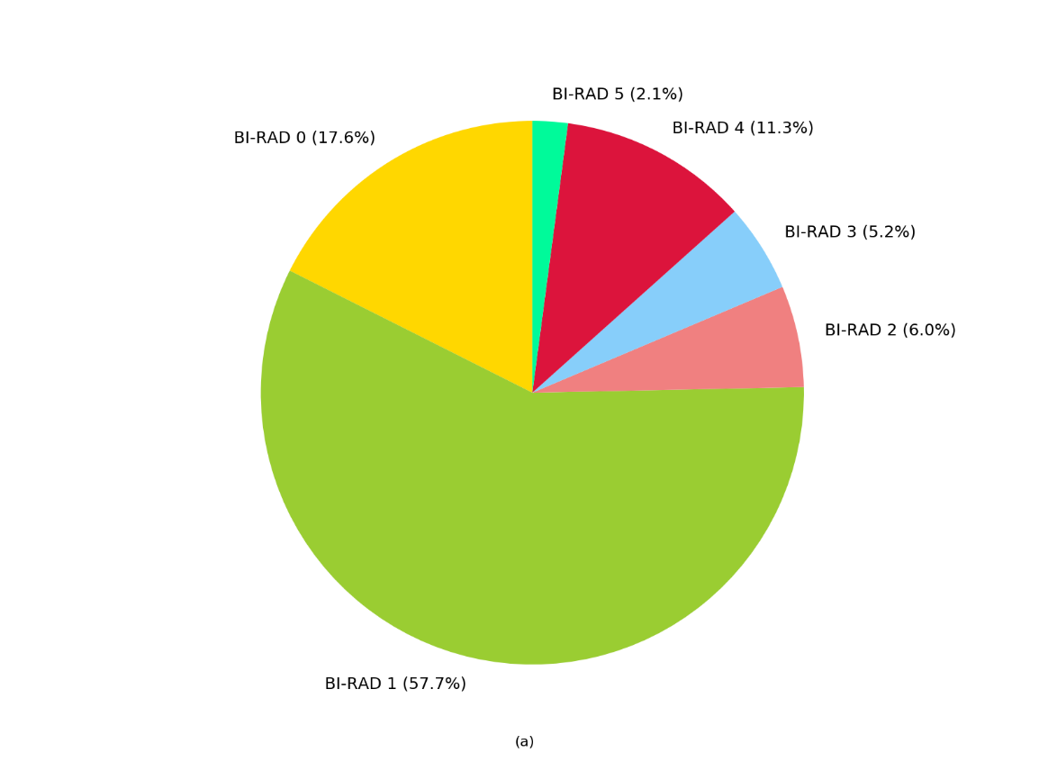
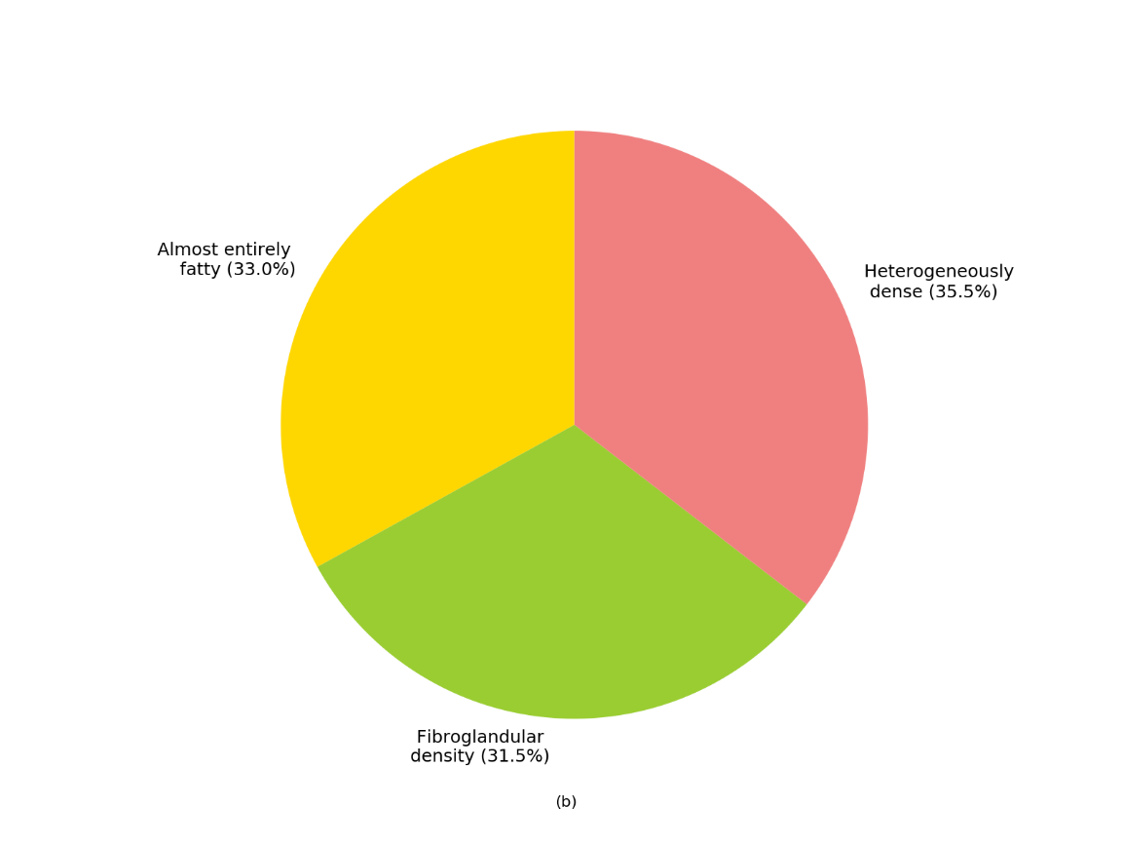
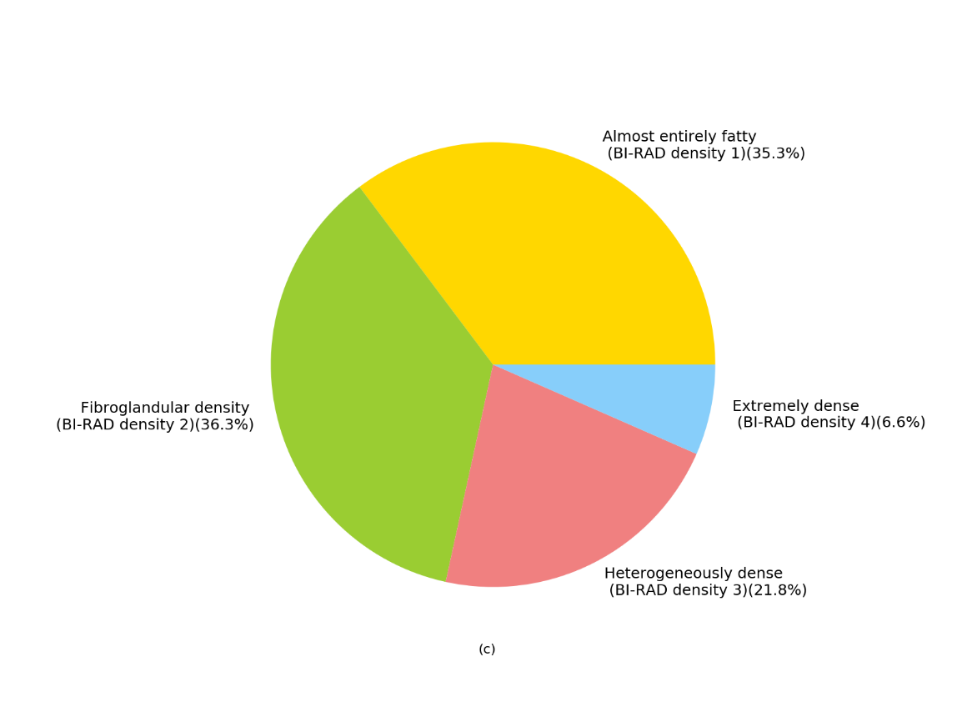

Slide 20



